Slide 1
Advanced HTTP 2
IN712 Web 3

Slide 2
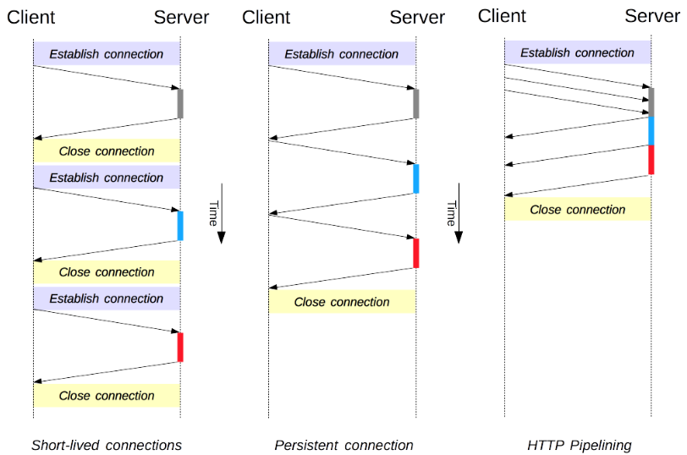
The 3 connection models of HTTP/1.x
HTTP mostly relies on TCP for its transport protocol, providing a connection between the client and the server.
In its infancy, HTTP used a short-lived: a new one created each time a request needed sending, and closed once the answer had been received
This simple model held an innate limitation on performance: opening each TCP connection is a resource-consuming operation (Network latency and bandwidth ).
Modern Web pages require many requests (a dozen or more) to serve the amount of information needed, proving this earlier model inefficient.
This motivated the innovation of using persistent connections
Pipelining was also introduced but it proved problematic and has been superseded by a better algorithm, multiplexing, that is used by HTTP/2.
Notes:
It's important point to note that connection management in HTTP applies to the connection between two consecutive nodes, which is hop-by-hop and not end-to-end. The model used in connections between a client and its first proxy may differ from the model between a proxy and the destination server (or any intermediate proxies). The HTTP headers involved in defining the connection model, like Connection and Keep-Alive, are hop-by-hop headers with their values able to be changed by intermediary nodes.
The original model of HTTP, and the default one in HTTP/1.0, is short-lived connections. Each HTTP request is completed on its own connection; this means a TCP handshake happens before each HTTP request, and these are serialized.
The TCP handshake itself is time-consuming, but a TCP connection adapts to its load, becoming more efficient with more sustained (or warm) connections. Short-lived connections do not make use of this efficiency feature of TCP, and performance degrades from optimum by persisting to transmit over a new, cold connection.
Short-lived connections have two major hitches: the time taken to establish a new connection is significant, and performance of the underlying TCP connection gets better only when this connection has been in use for some time (warm connection). To ease these problems, the concept of a persistent connection has been designed, even prior to HTTP/1.1. Alternatively this may be called a keep-alive connection.
A persistent connection is a one which remains open for a period, and can be reused for several requests, saving the the need for a new TCP handshake, and utilizing TCP's performance enhancing capabilities. This connection will not stay open forever: idle connections are closed after some time (a server may use the Keep-Alive header to specify a minimum time the connection should be kept open).

Slide 3
Content negotiation
In HTTP, content negotiation is the mechanism that is used for serving different versions of a resource at the same URI, so that the user agent can specify which is best suited for the user (for example, which language of a document, which image format, or which content encoding).
The determination of the best suited representation is made through one of two mechanisms:
Specific HTTP headers by the client as in server-driven negotiation or proactive negotiation), which is the standard way of negotiating a specific kind of resource. The server looks at the client's Accept headers and tries to match them with corresponding response headers.
The 300 (Multiple Choices) or 406 (Not Acceptable) HTTP response codes by the server as in agent-driven negotiation or reactive negotiation, that are used as fallback mechanisms.

Slide 4
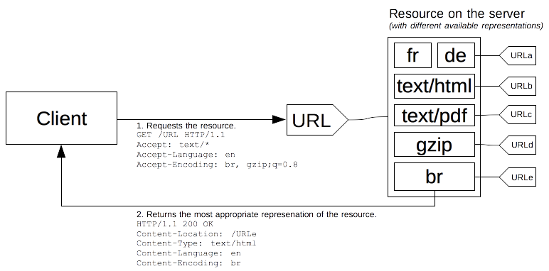
Server-driven content negotiation
A specific document is called a resource. When a client wants to obtain it, it requests it using its URL. The server uses this URL to choose one of the variants it provides – each variant being called a representation – and returns this specific representation to the client.
In server-driven content negotiation, or proactive content negotiation, the browser (or any other kind of user-agent) sends several HTTP headers along with the URL. These headers describe the preferred choice of the user. The server uses them as hints and an internal algorithm chooses the best content to serve to the client. The algorithm is server-specific (Apache, nginx, IIS…) and not defined in the standard.

Slide 5
Server-driven content negotiation
The HTTP/1.1 standard defines list of the standard headers that start server-driven negotiation: Accept (lists the MIME types of media resources that the agent is willing to process), Accept-Charset (character encodings understood by the user-agent, Utf-8), Accept-Encoding (supported compressions), Accept-Language (language preference of the user), User-Agent (identifies the browser sending the request)
The server uses the Vary header to indicate which headers it actually used for content negotiation (or more precisely the associated response headers), so that caches can work optimally.
In addition to these, there is an experimental proposal to add more headers to the list of available headers, called client hints (Accept-CH). Client hints advertise what kind of device the user agent runs on (for example, if it is a desktop computer or a mobile device, client's device pixel ratio, layout viewport width in CSS pixels)
Header values might also include an optional relative quality factor. It specifies what language the user would prefer, on a scale of 0 to 1.
Accept-Language: da, en-gb;q=0.8, en;q=0.7
Notes:
Even if server-driven content negotiation is the most common way to agree on a specific representation of a resource, it has several drawbacks:
The server doesn't have total knowledge of the browser. Even with the Client Hints extension, it has not a complete knowledge of the capabilities of the browser. Unlike reactive content negotiation where the client makes the choice, the server choice is always somewhat arbitrary.
The information by the client is quite verbose (HTTP/2 header compression mitigates this problem) and a privacy risk (HTTP fingerprinting)
As several representations of a given resource are sent, shared caches are less efficient and server implementations are more complex.
Compressing HTTP messages is one of the most important ways to improve the performance of a Web site, it shrinks the size of the data transmitted and makes better use of the available bandwidth; browsers always send this header and the server should be configured to abide to it and to use compression.

Slide 6
Agent-driven negotiation
Server-driven negotiation suffers from a few downsides:
it doesn't scale well.
There is one header per feature used in the negotiation.
If you want to use screen size, resolution or other dimensions, a new HTTP header must be created. Sending of the headers must be done on every request.
This is not too problematic with few headers, but with the eventual multiplications of them, the message size would lead to a decrease in performance. The more precise headers are sent, the more entropy is sent, allowing for more HTTP fingerprinting and corresponding privacy concern.
From the beginnings of HTTP, the protocol allowed another negotiation type: agent-driven negotiation or reactive negotiation. In this negotiation, when facing an ambiguous request, the server sends back a page containing links to the available alternative resources. The user is presented the resources and choose the one to use.

Slide 7
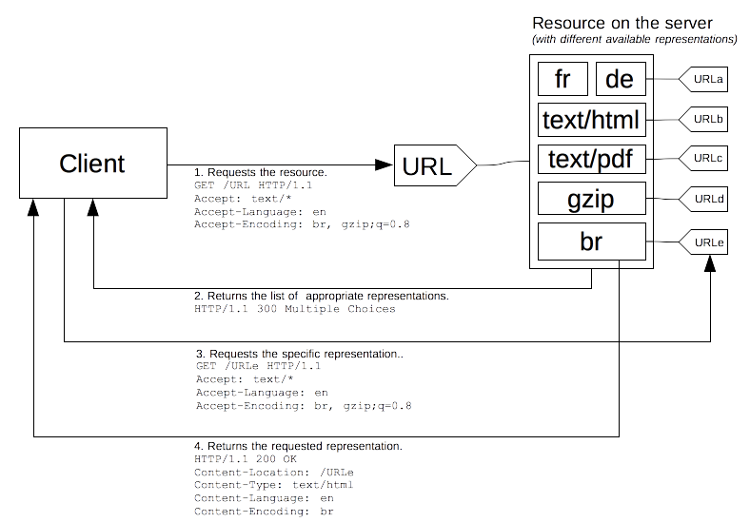
Agent-driven negotiation

Slide 8
Compression in HTTP
Compression is an important way to increase the performance of a Web site.
For some documents, size reduction of up to 70% lowers the bandwidth capacity needs.
Important for the mobile web due to lower bandwidth
In practice, web developers don't need to implement compression mechanisms, both browsers and servers implement it by default
Web developers have to ensure that the server is configured adequately for HTTP compression.
Compression happens at three different levels:
first some file formats are compressed with specific optimized methods,
then general encryption can happen at the HTTP level (the resource is transmitted compressed from end to end,
and finally compression can be defined at the connection level, between two nodes of an HTTP connection.

Slide 9
File format compression
Each data type has some redundancy, that is wasted space, in it.
Text can typically have as much as 60% redundancy, this rate can be much higher for some other media like audio and video.
Unlike text, these other media types take a lot of space to store
Engineers designed optimized compression algorithm used by file formats designed for specific purpose.
Compression algorithms used for files can be grouped in two wide categories:
Loss-less compression, where the compression-uncompression cycle doesn't alter the data that is recovered (png, gif)
Lossy compression, where the cycle alters the original data (jpeg, mp4)

Slide 10
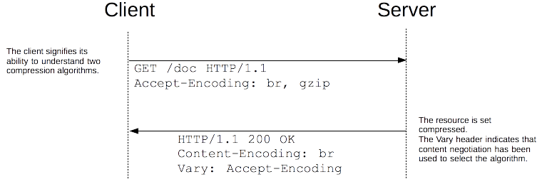
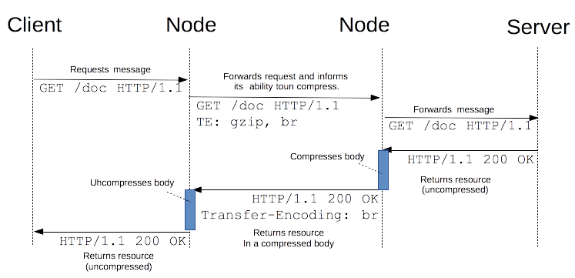
End-to-end compression vs Hop-by-hop compression
End-to-end compression refers to a compression of the body of a message that is done by the server and will last unchanged until it reaches the client..
Hop-by-hop compression: the compression doesn't happen on the resource in the server, creating a specific representation that is then transmitted, but on the body of the message between any two nodes on the path between the client and the server.
Notes:
For compression, end-to-end compression is where the largest performance improvements of Web sites reside
For hop by hop compression Connections between successive intermediate nodes may apply a different compression
To select the algorithm to use, browsers and servers use proactive content negotiation. The browser sends an Accept-Encoding header with the algorithm it supports and its order of precedence, the server picks one, uses it to compress the body of the response and uses the Content-Encoding header to tell the browser the algorithm it has chosen. As content negotiation has been used to chose a representation based on its encoding, a Vary header containing at least Content-Encoding must be sent alongside this header in the response; that way, cache will be able to cache the different representations of the resource.

Slide 11
HTTP conditional requests
HTTP conditional requests are requests that are executed differently depending on the value of specific headers. These headers define a precondition and the result of the request will be different if the precondition is matched or not.
The different behaviors are defined by the method of the request used and by the set of headers used for a precondition
For safe methods, like GET, which usually tries to fetch a document, the conditional request can be used to send back the document if relevant only and therefore spares bandwidth.
For unsafe methods, like PUT, which usually uploads a document, the conditional request can be used to upload the document only if the original it is based on is the same that is stored on the server.

Slide 12
Validators
All conditional headers try to check if the resource stored on the server matches a specific version. To achieve this, the conditional requests need to indicate the version of the resource.
As comparing the whole resource byte to byte is impractical, in those cases the request transmits a value describing the version: such values are called validators and are of two kinds:
the date of last modification of the document, the last-modified date.
an opaque string, uniquely identifying each version, called the entity tag or the etag.

Slide 13
Validators
Comparing versions of the same resource is a bit tricky: depending of the context, there are two kind of equality checks.
Strong validation is used when byte to byte identity is expected, for example when resuming a download. Strong validation consists in guaranteeing that the resource is byte to byte identical to the one it is compared too. This is mandatory for some conditional headers, and the default for the others. Strong validation is very strict and may be difficult to guarantee at the server level, but it does guarantees no data loss at any time, sometimes at the expense of performance. It is quite difficult to have a unique identifier for strong validation with Last-Modified. Often this is done using an ETag with the MD5 hash of the resource (or a derivative).
Weak validation is used when the user-agent only needs to determine if the two resources have approximately the same content, even if they are minor difference (like different ads, or a footer with a different date). For example, a page that would differ from another only by a different date in its footer, or by different advertisement, would be considered as identical to the other with weak validation, but will be considered as different with strong validation. Building a system of etags that creates weak validation may be complex as it involves knowing the importance of the different elements of a page, but is very useful to optimize caching performance.
The kind of validation is independent of the validator used; both Last-Modified and ETag allow both types of validation though the complexity to implement it on the server side may vary. HTTP uses strong validation by default, and it specifies when weak validation can be used.

Slide 14
Conditional headers
Several HTTP headers, called conditional headers, lead to conditional requests. These are:
If-Match: Succeeds if the ETag of the distant resource is equal to one listed in this header. By default, unless the Etag is prefixed with 'W/', it performs a strong validation.
If-None-Match: Succeeds if the ETag of the distant resource is different to each listed in this header. By default, unless the Etag is prefixed with 'W/', it performs a strong validation.
If-Modified-Since: Succeeds if the Last-Modified date of the distant resource is more recent than the one given in this header.
If-Unmodified-Since: Succeeds if the Last-Modified date of the distant resource is older or the same than the one given in this header.
If-Range: Similar to If-Match, or If-Unmodified-Since, but can have only one single etag, or one date. If it fails, a the range request fails and, instead of a 206 Partial Content response, a 200 OK is sent with the complete resource.

Slide 15
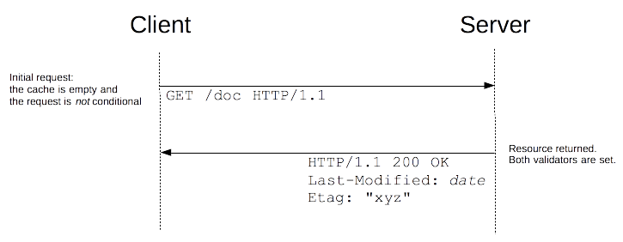
Use cases of HTTP conditional requests Cache update
The most common use case for conditional requests is updating a cache. With an empty cache, or without a cache, the requested resources is sent back with a status of 200 OK.
Together with the resource, the validators are sent in the headers. In this example, both Last-Modified and ETag are sent, but it could have been only one of them as well. These validators are cached with the resource (like all headers) and will be used to craft conditional requests once the cache becomes stale.

Slide 16
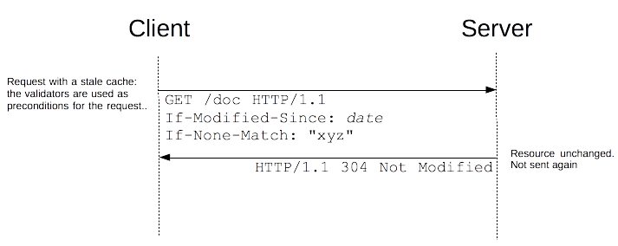
Use cases of HTTP conditional requests Cache update
As long as the cache is not stale, no requests are issued at all. But once, it has become stale, this is mostly controlled by the Cache-Control header, the client doesn't use the cached value directly but issues a conditional request, with the value of the validator used as parameter of the If-Modified-Since and If-Match headers.
If the resource has not been changed, the server sends back a 304 Not Modified response, which makes the cache fresh again and the client use the cached resource. Although there is a response/request round-trip that consumes some resources, this is more efficient than to transmit the whole resource over the wire again.

Slide 17
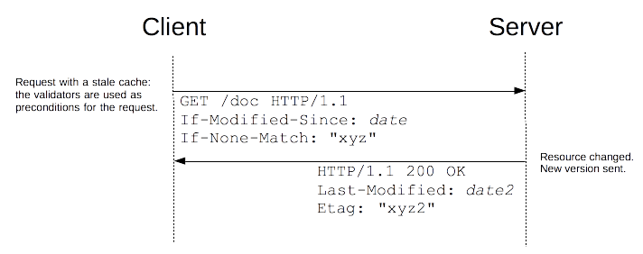
Use cases of HTTP conditional requests Cache update
If the resource has changed, the server just sends back a 200 OK response, with the new version of the resource, like if the request wasn't conditional and the client use this new resource (and caches it).
Besides setting the validators on the server side, this mechanism is transparent: all browsers manage a cache and send such conditional requests without any special work to be done by Web developers.

Slide 18
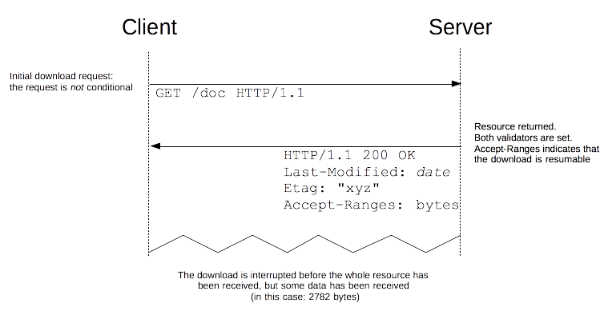
Use cases of HTTP conditional requests Integrity of a partial download
Partial downloading of files is a functionality of HTTP that allows to resume previous operations, saving bandwidth and time by keeping the already obtained information.

Slide 19
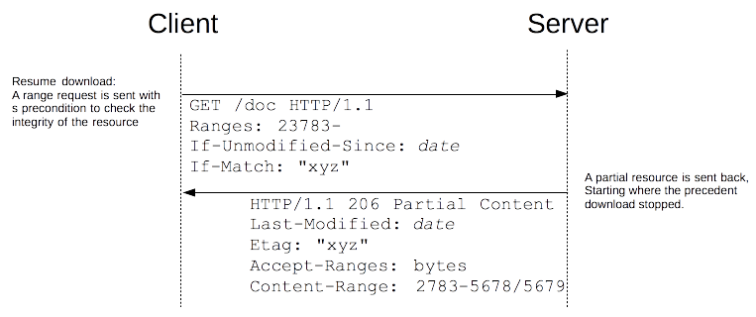
Use cases of HTTP conditional requests Integrity of a partial download
A server supporting partial downloads advertised it by sending the Accept-Ranges header. When this happens, the client can resume a download by sending a Ranges header with the missing ranges.

Slide 20
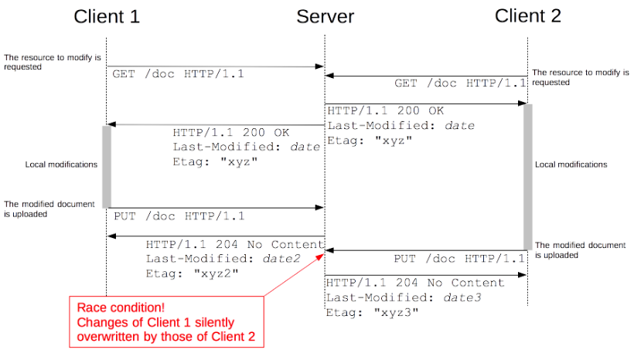
Use cases of HTTP conditional requests Avoiding the lost update problem with optimistic locking
A common operation in Web applications is to update a remote document. With the PUT method you are able to implement this. The client first reads the original files, modifies them and finally pushes them to the server.
Unfortunately, things get a little bit awry as soon as we take into account concurrency. While a client is modifying locally its new copy of the resource, a second client can fetch the same resource and do the same on its side. What happens then is very unfortunate: when they commit back, the modifications of the first client to push are discarded by the next push, as the second client is unaware of the new changes. This is a race condition and leads to problematic behaviors difficult to detect and to debug.
Notes:
The decision about who wins in a race condition is not communicated to the other party, but which client's changes will be kept will vary with the speed they commit, which depends on the performance of the clients, of the server, and even of the human editing the document at the client: the winner will change from one time to another.

Slide 21
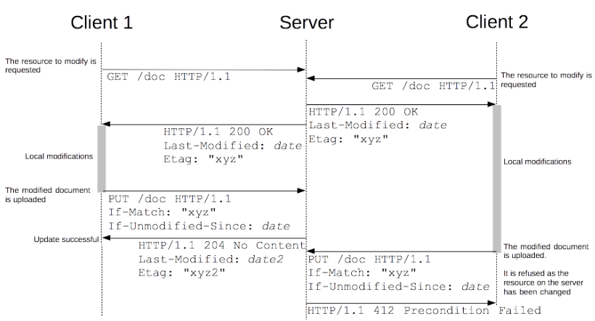
Use cases of HTTP conditional requests Avoiding the lost update problem with optimistic locking
There is no way in dealing with this problem without annoying one of the two clients. But lost updates and race conditions are to be avoided: we want a predictable results and that the clients are notified when their changes are rejected.
Conditional requests allow to implement the optimistic locking algorithm (used by most wikis or source control systems). The idea is to allow all clients to get copies of the resource, to let them modify it locally and to control concurrency by allowing the first client submitting an update to do it successfully, all subsequent updates based on the now obsolete version of the resource are rejected.

Slide 22
Content Security Policy (CSP)
Content Security Policy (CSP) is an added layer of security that helps to detect and mitigate certain types of attacks, including Cross Site Scripting (XSS) and data injection attacks.
These attacks are used for everything from data theft to site defacement or distribution of malware.
To enable CSP, you need to configure your web server to return the Content-Security-Policy HTTP header
Alternatively, the <meta> element can be used in your HTML to configure a policy, for example: <meta http-equiv="Content-Security-Policy" content="default-src 'self'; image-src https:*; child-src 'none';">

Slide 23
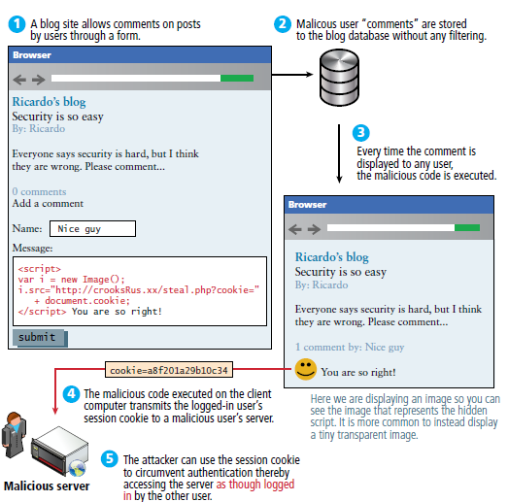
Threats - Mitigating cross site scripting
•A primary goal of CSP is to mitigate and report XSS attacks. XSS attacks exploit the browser's trust of the content received from the server.
•Malicious scripts are executed by the victim's browser because the browser trusts the source of the content, even when it's not coming from where it seems to be coming from.
•CSP makes it possible for server administrators to reduce or eliminate the vectors by which XSS can occur by specifying the domains that the browser should consider to be valid sources of executable scripts.
•CSP compatible browsers will only execute scripts loaded in source files received from whitelisted domains, ignoring all other script, including inline scripts and event-handling HTML attributes

Slide 24
Threats - Mitigating packet sniffing attacks
In addition to restricting the domains from which content can be loaded, the server can specify which protocols are allowed to be used; for example (and ideally, from a security standpoint), a server can specify that all content must be loaded using HTTPS.
A complete data transmission security strategy includes not only enforcing HTTPS for data transfer, but also marking all cookies with the secure flag and providing automatic redirects from HTTP pages to their HTTPS counterparts. Sites may also use the Strict-Transport-Security HTTP header to ensure that browsers connect to them only over an encrypted channel.

Slide 25
Using CSP
Configuring Content Security Policy involves adding the Content-Security-Policy HTTP header to a web page and giving it values to control resources the user agent is allowed to load for that page. For example, a page that uploads and displays images could allow images from anywhere, but restrict a form action to a specific endpoint.
A properly designed Content Security Policy helps protect a page against a cross site scripting attack.
You can use the Content-Security-Policy HTTP header to specify your policy
The policy is a string containing the policy directives describing your Content Security Policy.

Slide 26
Writing a policy
A web site administrator wants all content to come from the site's own origin (this excludes subdomains.)
Content-Security-Policy: default-src 'self
A web site administrator wants to allow content from a trusted domain and all its subdomains (it doesn't have to be the same domain that the CSP is set on.)
Content-Security-Policy: default-src 'self' *.trusted.com
A web site administrator wants to allow users of a web application to include images from any origin in their own content, but to restrict audio or video media to trusted providers, and all scripts only to a specific server that hosts trusted code.
Content-Security-Policy: default-src 'self'; img-src *; media-src media1.com media2.com; script-src userscripts.example.com
note the "*" wildcard to indicate that images may load from anywhere
A web site administrator for an online banking site wants to ensure that all its content is loaded using SSL, in order to prevent attackers from eavesdropping on requests.
Content-Security-Policy: default-src https://onlinebanking.jumbobank.com
A web site administrator of a web mail site wants to allow HTML in email, as well as images loaded from anywhere, but not JavaScript or other potentially dangerous content.
Content-Security-Policy: default-src 'self' *.mailsite.com; img-src *
Notes:
A policy is described using a series of policy directives, each of which describes the policy for a certain resource type or policy area. Your policy should include a default-src policy directive, which is a fallback for other resource types when they don't have policies of their own.
A policy needs to include a default-src or script-src directive to prevent inline scripts from running, as well as blocking the use of eval(). A policy needs to include a default-src or style-src directive to restrict inline styles from being applied from a <style> element or a style attribute.

Slide 27
Testing your policy
To ease deployment, CSP can be deployed in report-only mode. The policy is not enforced, but any violations are reported to a provided URI. Additionally, a report-only header can be used to test a future revision to a policy without actually deploying it.
You can use the Content-Security-Policy-Report-Only HTTP header to specify your policy
Content-Security-Policy-Report-Only: policy
If both a Content-Security-Policy-Report-Only header and a Content-Security-Policy header are present in the same response, both policies are honored. The policy specified in Content-Security-Policy headers is enforced while the Content-Security-Policy-Report-Only policy generates reports but is not enforced.
By default, violation reports aren't sent. To enable violation reporting, you need to specify the report-uri policy directive, providing at least one URI to which to deliver the reports:
Content-Security-Policy: default-src 'self'; report-uri http://reportcollector.example.com/collector.cgi

Slide 28
Sample violation report
Let's consider a page located at http://example.com/signup.html. It uses the following policy, disallowing everything but stylesheets from cdn.example.com.
Content-Security-Policy: default-src 'none'; style-src cdn.example.com; report-uri /_/csp-reports
The HTML of signup.html looks like this:
<!DOCTYPE html>
<html>
<head>
<title>Sign Up</title>
<link rel="stylesheet" href="css/style.css">
</head>
<body>
... Content ...
</body>
</html>
Can you spot the mistake? Stylesheets are only allowed to be loaded from cdn.example.com, yet the website tries to load one from its own origin (http://example.com/css). A browser capable of enforcing CSP will send the following violation report as a POST request to http://example.com/_/csp-reports, when the document is visited:
{
"csp-report": {
"document-uri": "http://example.com/signup.html",
"referrer": "",
"blocked-uri": "http://example.com/css/style.css",
"violated-directive": "style-src cdn.example.com",
"original-policy": "default-src 'none'; style-src cdn.example.com; report-uri /_/csp-reports"
}
}

Slide 29
References
https://developer.mozilla.org/en-US/docs/Web/HTTP/Compression
https://developer.mozilla.org/en-US/docs/Web/HTTP/Connection_management_in_HTTP_1.x
https://developer.mozilla.org/en-US/docs/Web/HTTP/Content_negotiation
https://developer.mozilla.org/en-US/docs/Web/HTTP/Conditional_requests
https://developer.mozilla.org/en-US/docs/Web/HTTP/CSP

